Slide 1
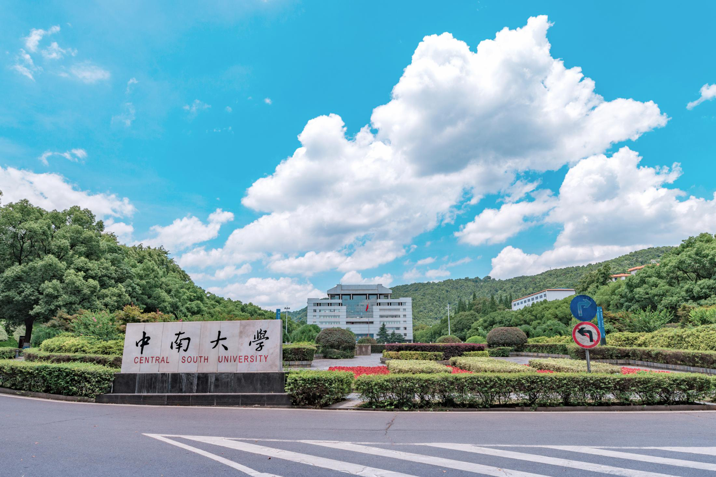

中
之
南
春
中南大学合并组建二十周年
汇报人：中南云麓谷

Slide 2
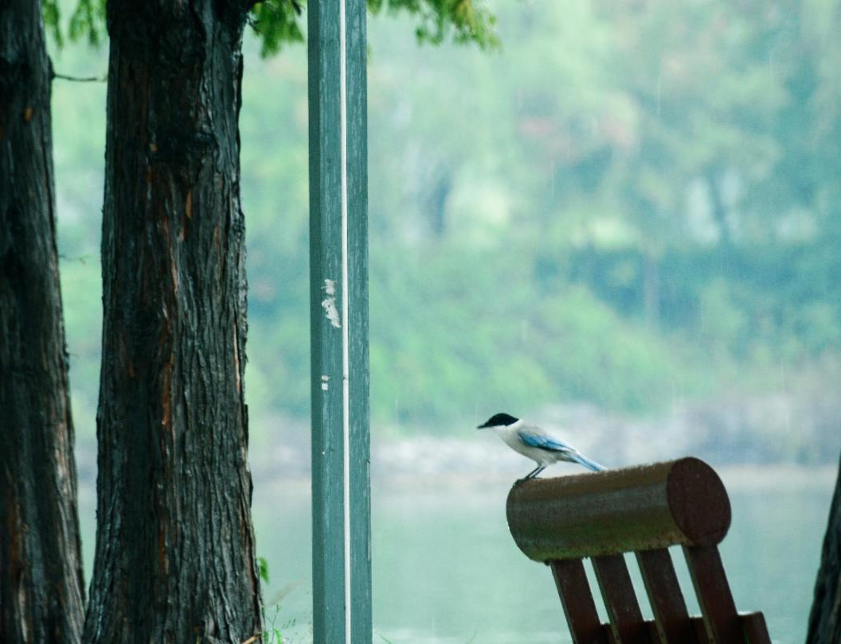

请在此处添加您的标题、文字
If you are ever in trouble, don't try to be brave, just run, just run away.
1
2
请在此处添加您的标题、文字
If you are ever in trouble, don't try to be brave, just run, just run away.
Contents
3
请在此处添加您的标题、文字
If you are ever in trouble, don't try to be brave, just run, just run away.
4
请在此处添加您的标题、文字
If you are ever in trouble, don't try to be brave, just run, just run away.

Slide 3
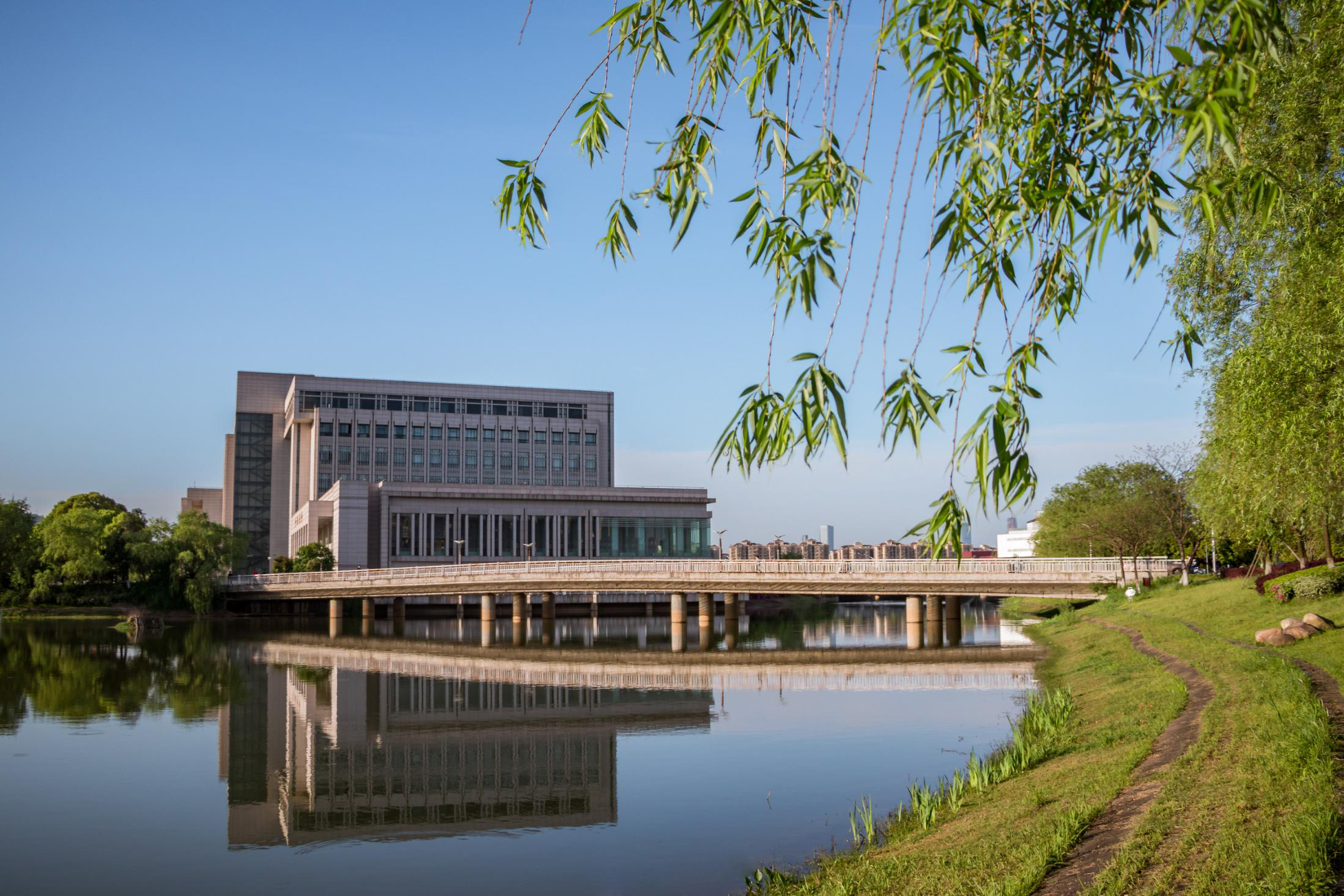
01
请在此处添加您
的标题、文字

Slide 4
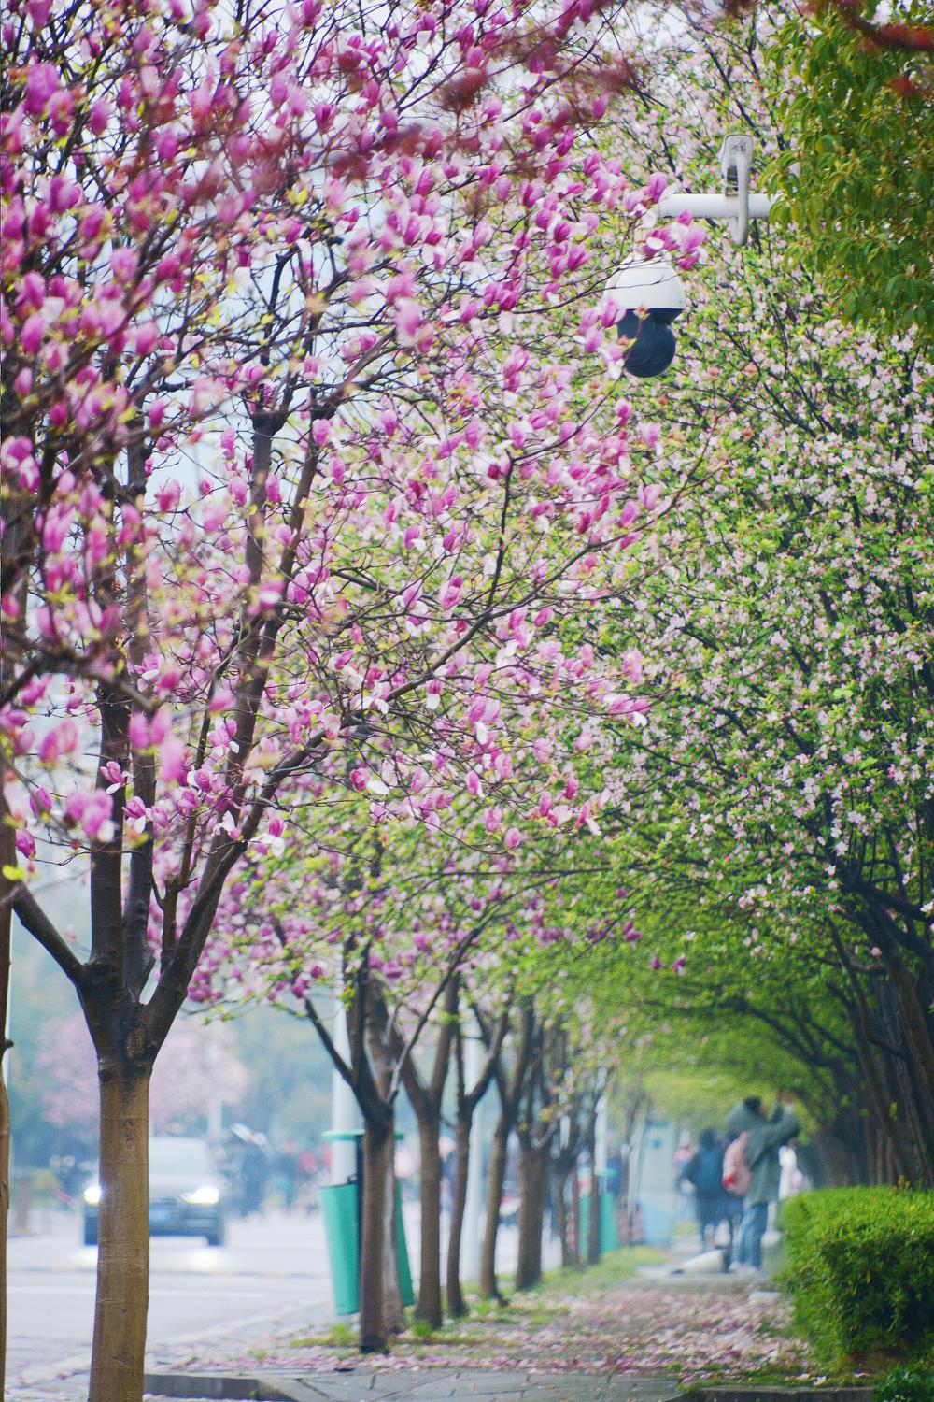
请在此处添加您
的标题、文字
请在此处添加您的标题、文字
I love you more than I've ever loved any woman. And I've waited longer for you than I've waited for any woman.
I love you more than I've ever loved any woman. And I've waited longer for you than I've waited for any woman.
I love you more than I've ever loved any woman. And I've waited longer for you than I've waited for any woman.
I love you more than I've ever loved any woman. And I've waited longer for you than I've waited for any woman.

Slide 5
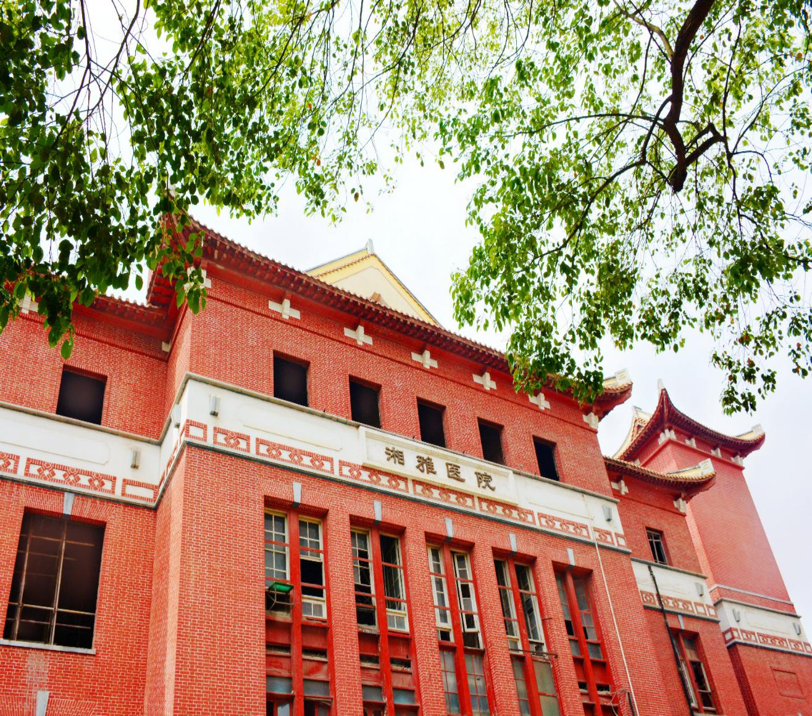
ALL OR NOTHING
NOW OR NEVER
Click here to add your title
I love you more than I've ever loved any woman. And I've waited longer for you than I've waited for any woman.
I love you more than I've ever loved any woman. And I've waited longer for you than I've waited for any woman.
I love you more than I've ever loved any woman. And I've waited longer for you than I've waited for any woman.

Slide 6
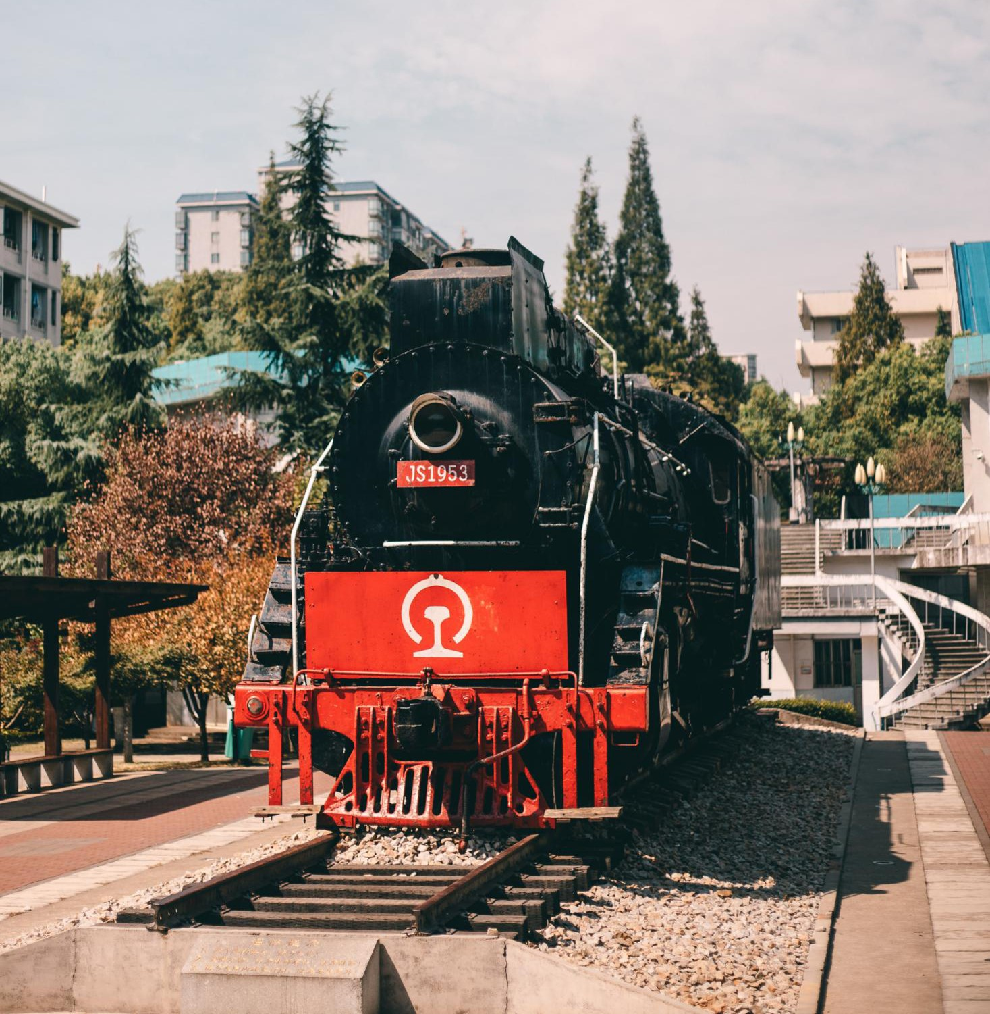
请在此处添加您的标题、文字
请在此处添加您的标题、文字
I love you more than I've ever loved any woman. And I've waited longer for you than I've waited for any woman.
I love you more than I've ever loved any woman. And I've waited longer for you than I've waited for any woman.
I love you more than I've ever loved any woman. And I've waited longer for you than I've waited for any woman.

Slide 7

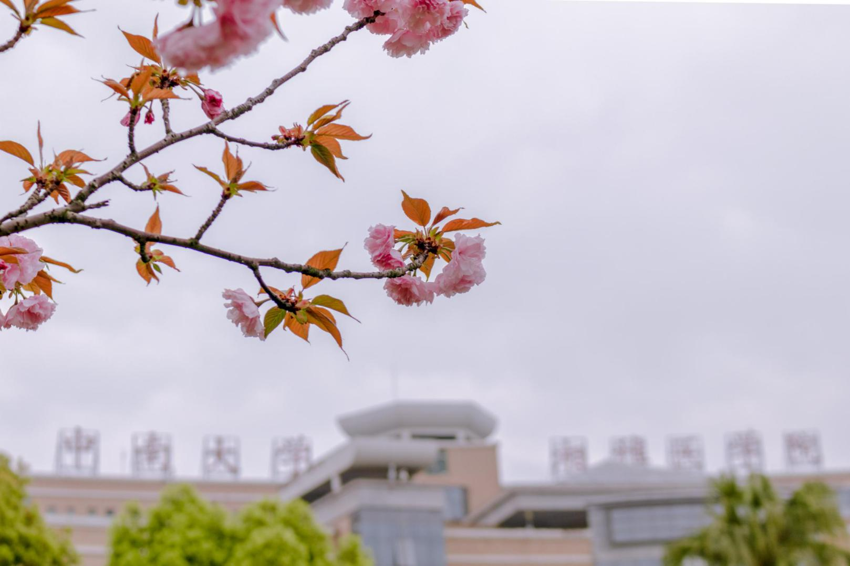
Click here to add your title
I love you more than I've ever loved any woman. And I've waited longer for you than I've waited for any woman.
I love you more than I've ever loved any woman. And I've waited longer for you than I've waited for any woman.
知行合一 经世致用

Slide 8
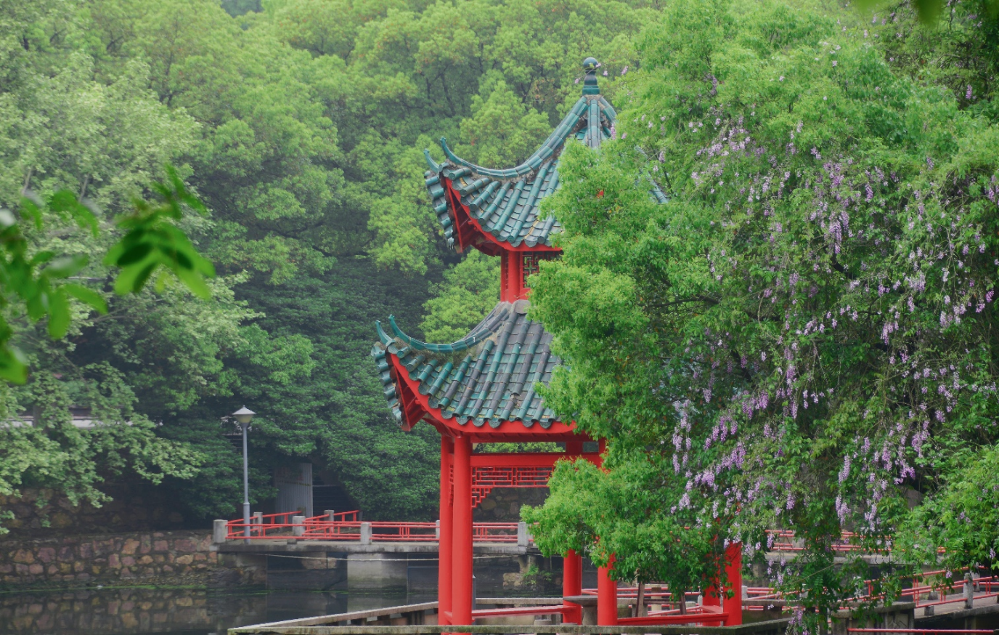
请在此处添加您
的标题、文字
I love you more than I've ever loved any woman. And I've waited longer for you than I've waited for any woman.I love you more than I've ever loved any woman. And I've waited longer for you than I've waited for any woman.
I love you more than I've ever loved any woman. And I've waited longer for you than I've waited for any woman.
知行合一 经世致用
Central South University

Slide 9

02
请在此处添加您的标题、文字
知行合一
经世致用
请在此处添加您的标题、文字
请在此处添加您的标题、文字
请在此处添加您的标题、文字
知行合一 经世致用
Central South University

Slide 10
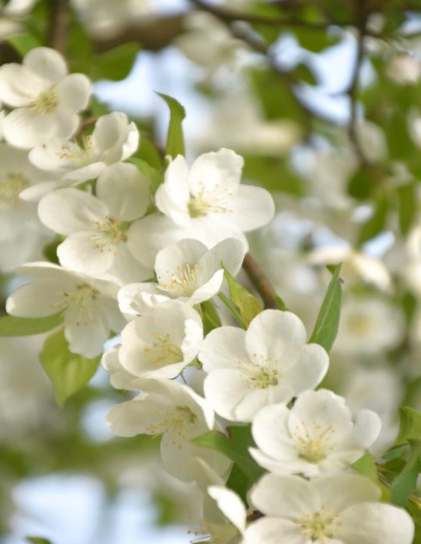

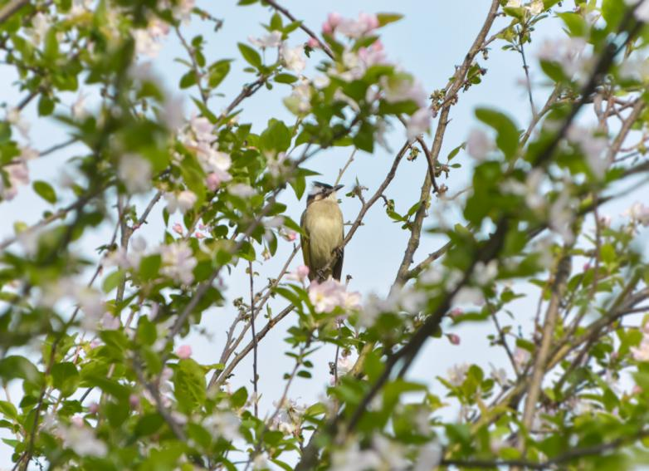
请在此处添加您
的标题、文字
Click here to add your title
I love you more than I've ever loved any woman. And I've waited longer for you than I've waited for any woman.
I love you more than I've ever loved any woman. And I've waited longer for you than I've waited for any woman.
I love you more than I've ever loved any woman. And I've waited longer for you than I've waited for any woman.

Slide 11
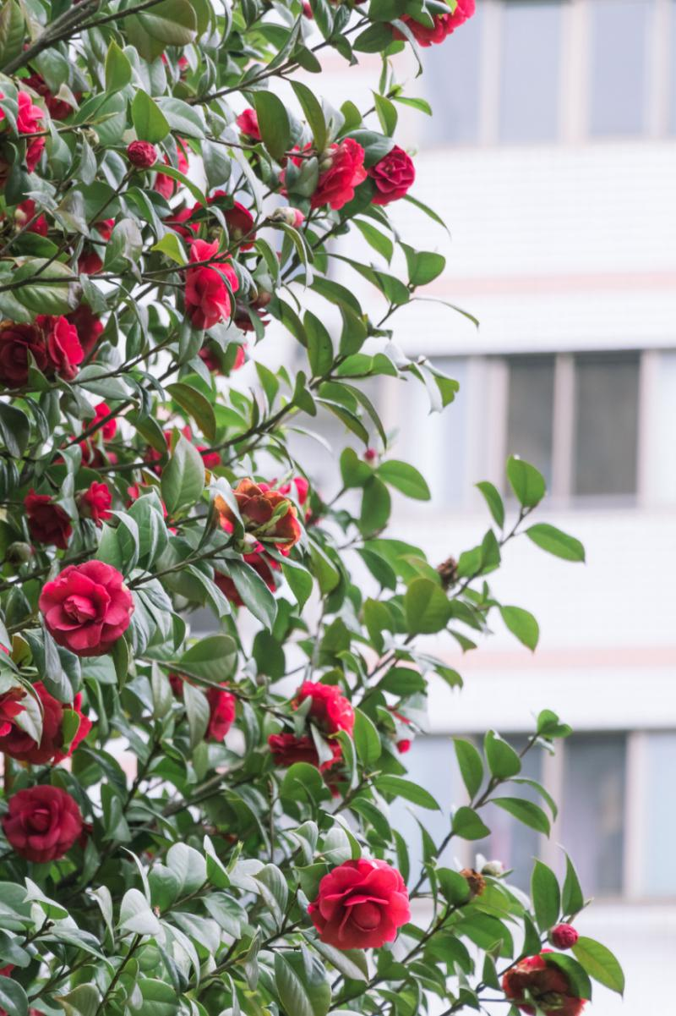
Click here to add your title
I love you more than I've ever loved any woman. And I've waited longer for you than I've waited for any woman.
Click here to add your title
I love you more than I've ever loved any woman. And I've waited longer for you than I've waited for any woman.
Click here to add your title
I love you more than I've ever loved any woman. And I've waited longer for you than I've waited for any woman.

Slide 12
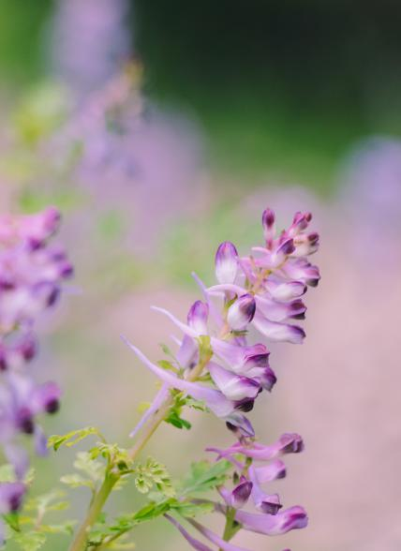

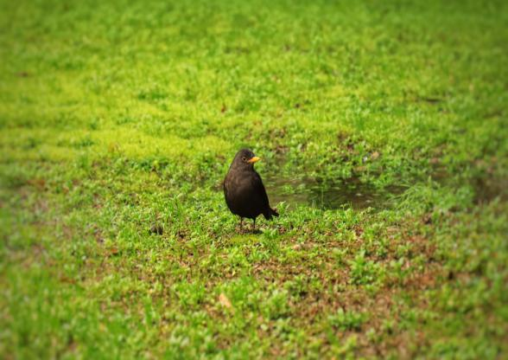


请在此处添加您
的标题、文字
Click here to add your title
I love you more than I've ever loved any woman. And I've waited longer for you than I've waited for any woman.
I love you more than I've ever loved any woman. And I've waited longer for you than I've waited for any woman.
I love you more than I've ever loved any woman. And I've waited longer for you than I've waited for any woman.

Slide 13
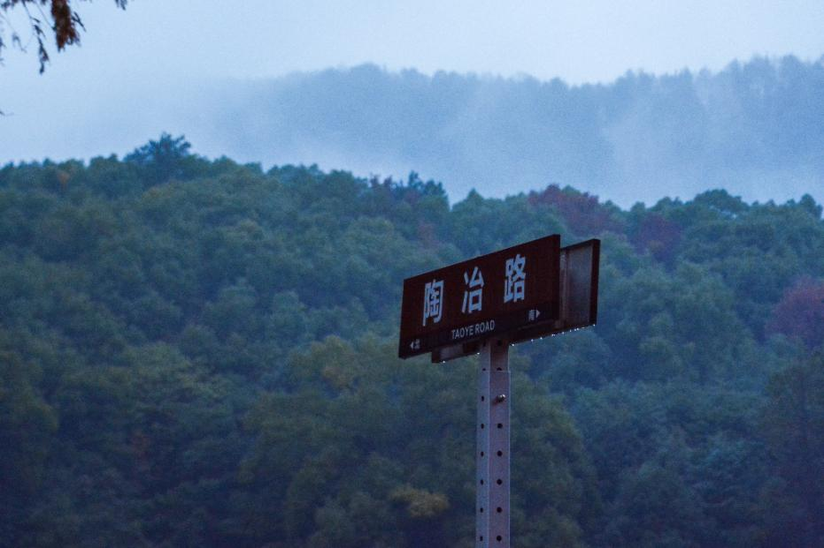
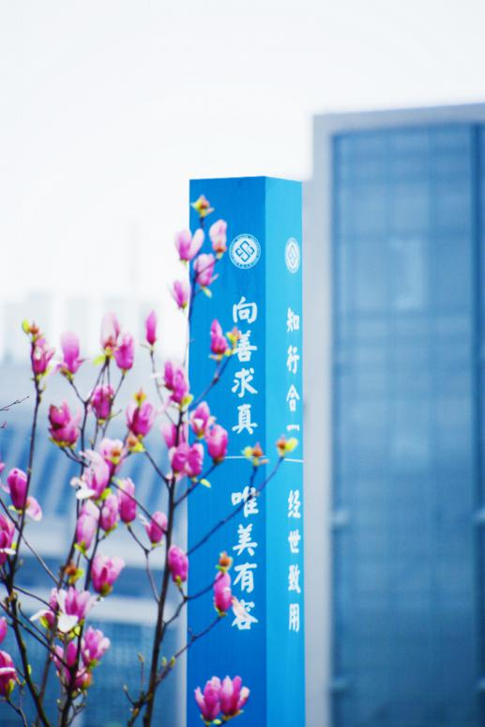
请在此处添加您
的标题、文字
Click here to add your title
I love you more than I've ever loved any woman. And I've waited longer for you than I've waited for any woman.I love you more than I've ever loved any woman. And I've waited longer for you than I've waited for any woman.I love you more than I've ever loved any woman. And I've waited longer for you than I've waited for any woman.
I love you more than I've ever loved any woman. And I've waited longer for you than I've waited for any woman.I love you more than I've ever loved any woman. And I've waited longer for you than I've waited for any woman.

Slide 14
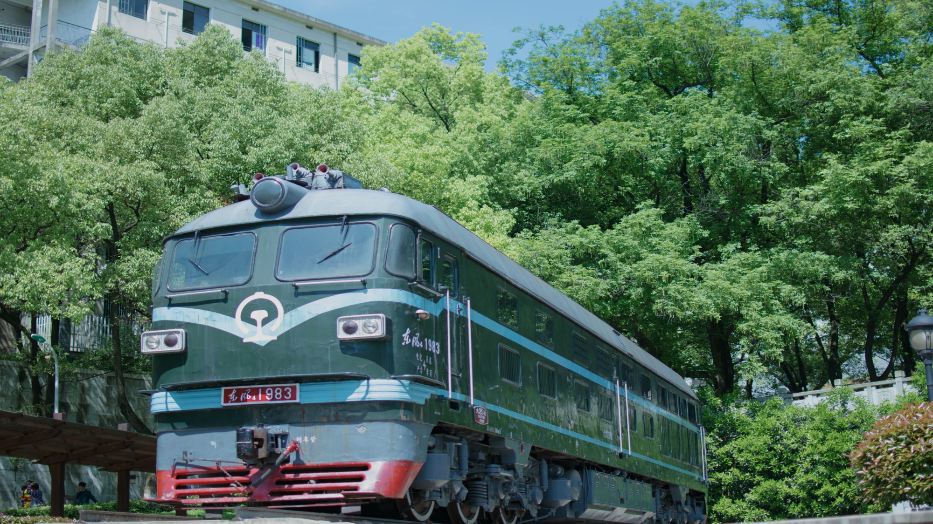
03
请在此处添加您
的标题、文字

Slide 15

请在此处添加您的标题、文字
I love you more than I've ever loved any woman. And I've waited longer for you than I've waited for any woman.I ve you more than I've ever loved any woman. And I've waited longer for you than I've waited for any woman.
I love you more than I've ever loved any woman. And I've waited longer for you than I've waited for any woman.

Slide 16
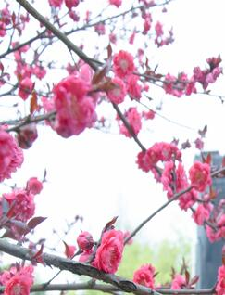



请在此处添加您
的标题、文字
Click here to add your title
I love you more than I've ever loved any woman. And I've waited longer for you than I've waited for any woman.
I love you more than I've ever loved any woman. And I've waited longer for you than I've waited for any woman.
I love you more than I've ever loved any woman. And I've waited longer for you than I've waited for any woman.

Slide 17

Click here to add your title
I love you more than I've ever loved any woman. And I've waited longer for you than I've waited for any woman.
Click here to add your title
Click here to add your title
I love you more than I've ever loved any woman. And I've waited longer for you than I've waited for any woman.
I love you more than I've ever loved any woman. And I've waited longer for you than I've waited for any woman.
I love you more than I've ever loved any woman. And I've waited longer for you than I've waited for any woman.I love you more than I've ever loved any woman. And I've waited longer for you than I've waited for any woman.
Click here to add your title
I love you more than I've ever loved any woman. And I've waited longer for you than I've waited for any woman.

Slide 18
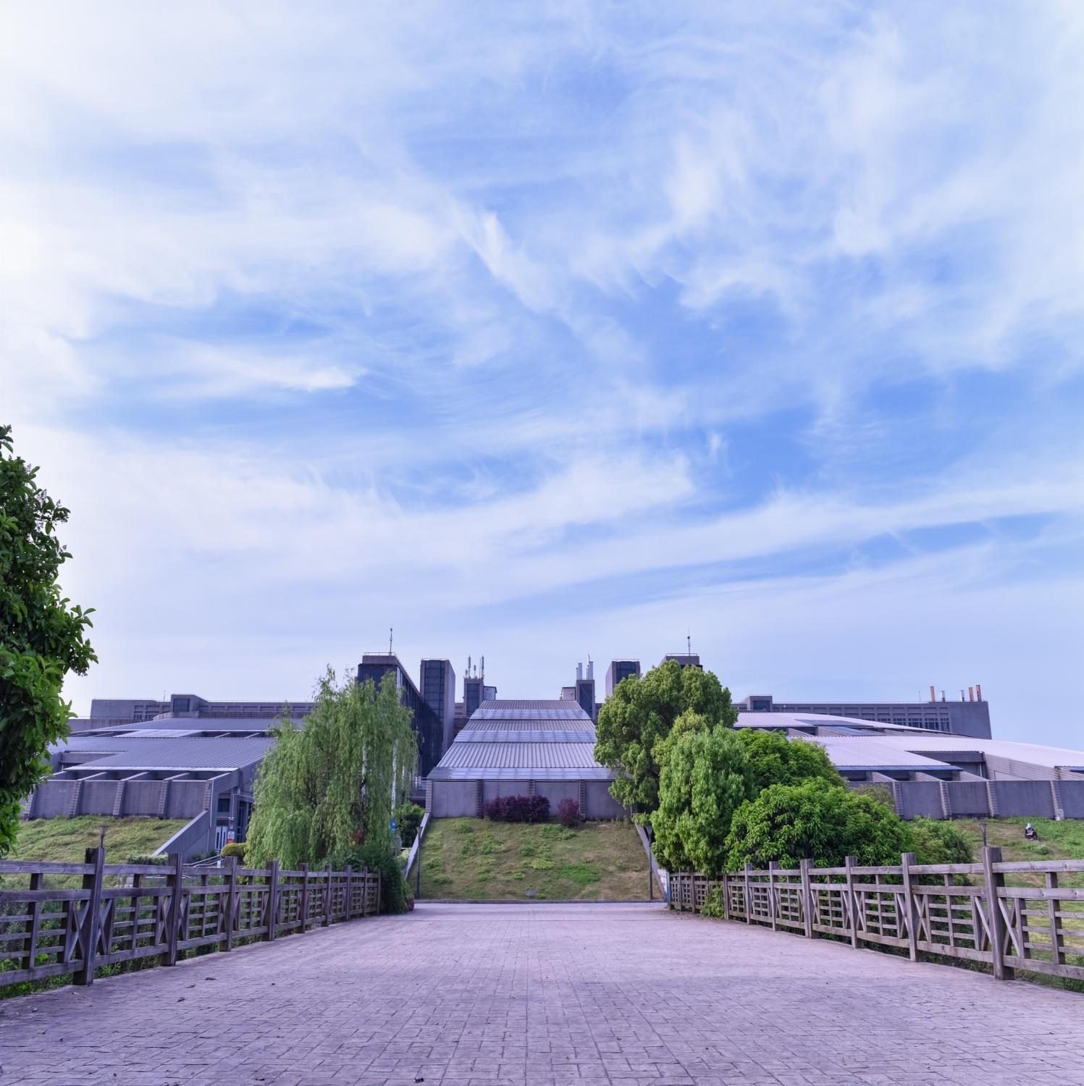
ALL OR NOTHING
NOW OR NEVER
Click here to add your title
I love you more than I've ever loved any woman. And I've waited longer for you than I've waited for any woman.
I love you more than I've ever loved any woman. And I've waited longer for you than I've waited for any woman.
I love you more than I've ever loved any woman. And I've waited longer for you than I've waited for any woman.

Slide 19
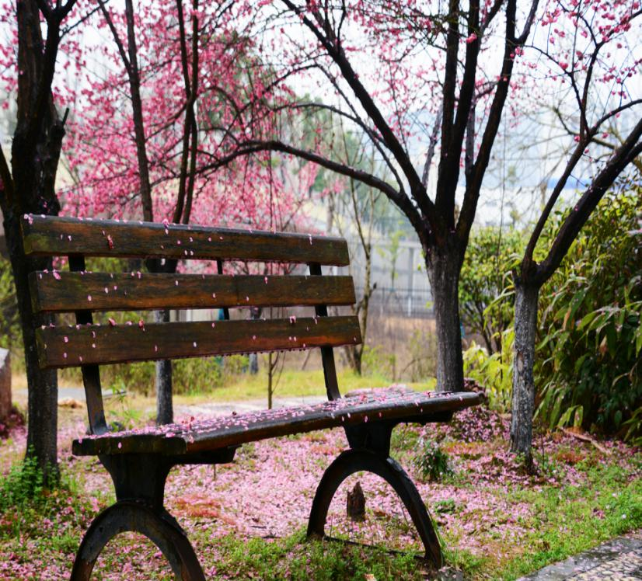
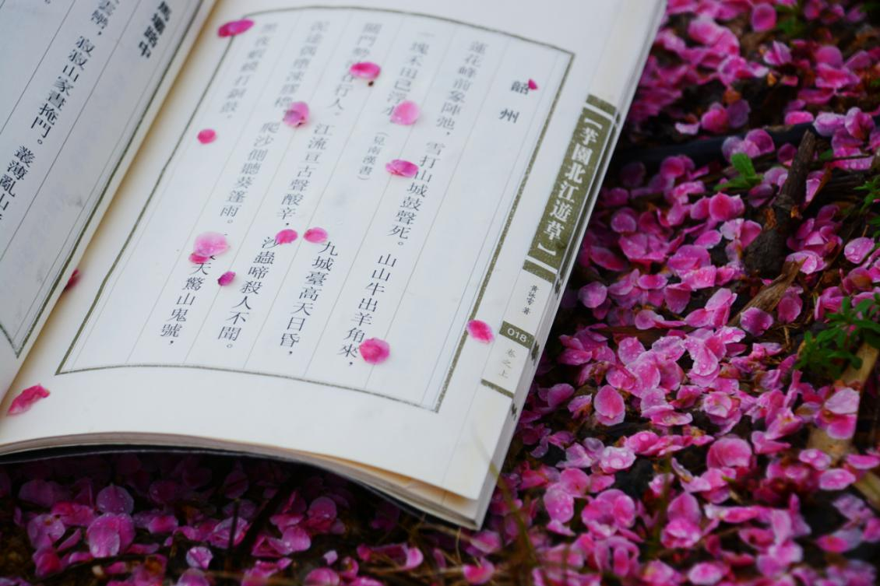
请在此处添加您的标题、文字
I love you more than I've ever loved any woman. And I've waited longer for you than I've waited for any woman.I love you more than I've ever loved any woman. And I've waited longer for you than I've waited for any woman.
I love you more than I've ever loved any woman. And I've waited longer for you than I've waited for any woman.I love you more than I've ever loved any woman. And I've waited longer for you than I've waited for any woman.
请在此处添加您
的标题、文字

Slide 20
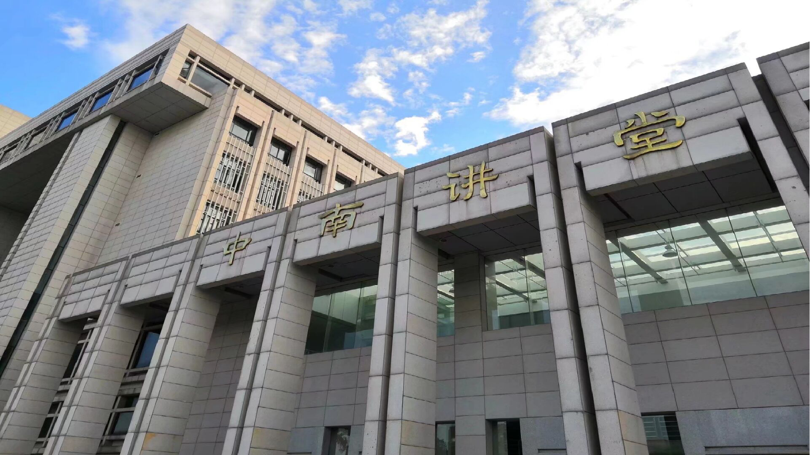
04
请在此处添加您的标题文字

Slide 21
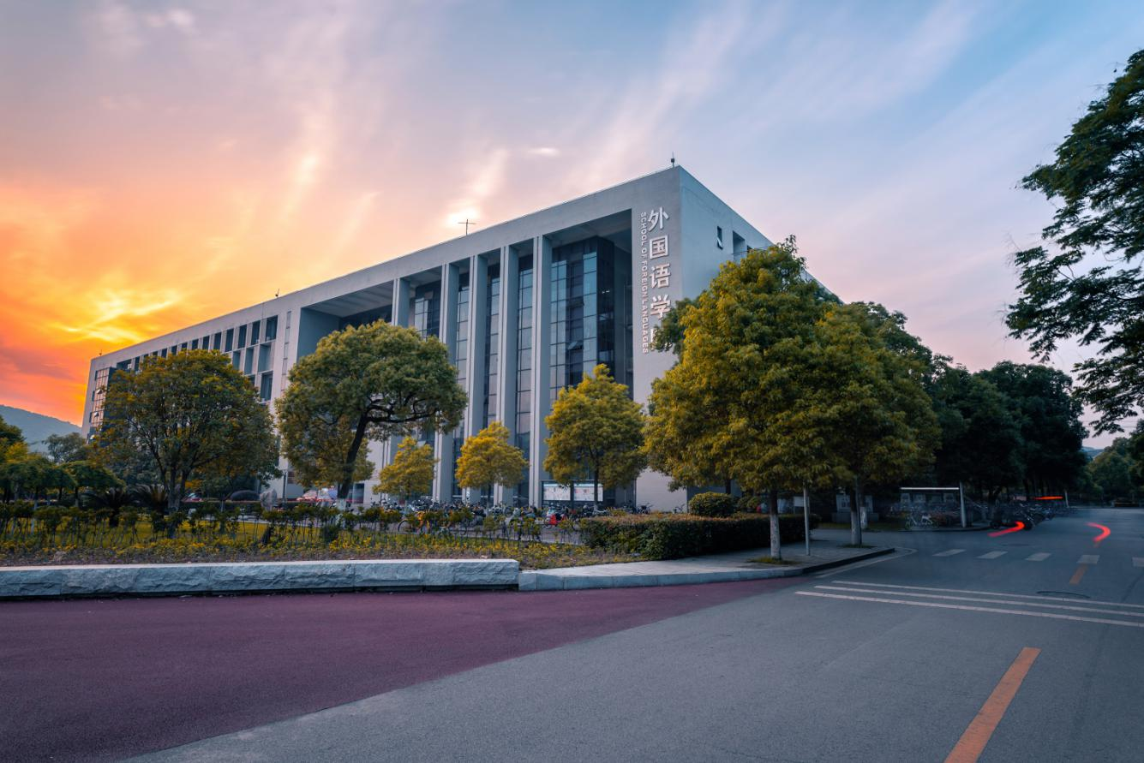
请在此处添加您的标题、文字
I love you more than I've ever loved any woman. And I've waited longer for you than I've waited for any woman.
I love you more than I've ever loved any woman. And I've waited longer for you than I've waited for any woman.
I love you more than I've ever loved any woman. And I've waited longer for you than I've waited for any woman.

Slide 22

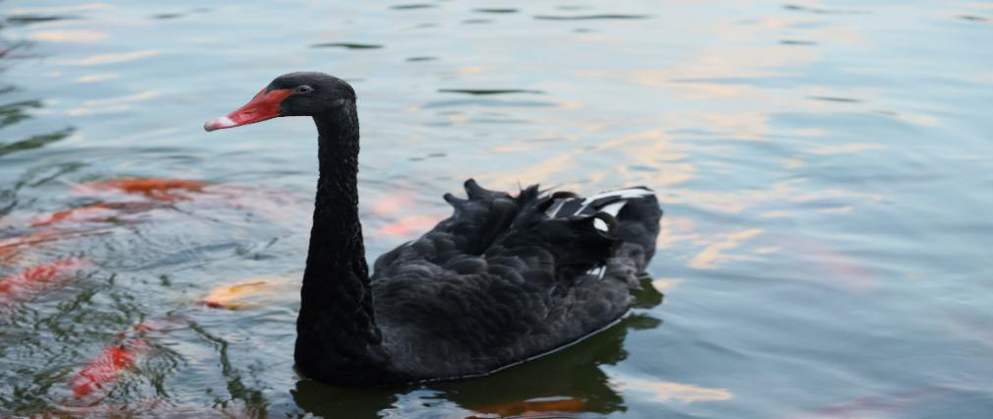
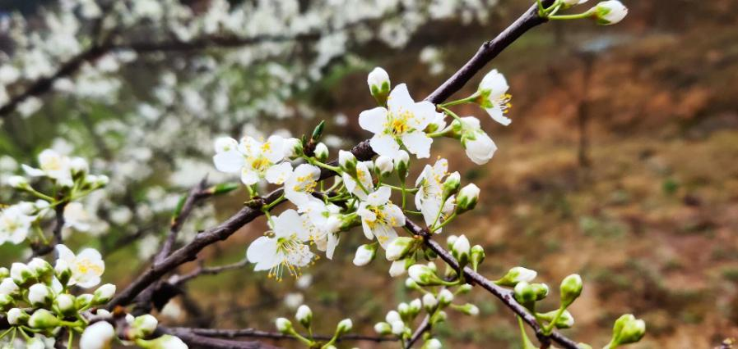

请在此处添加您
的标题、文字
Click here to add your title
I love you more than I've ever loved any woman. And I've waited longer for you than I've waited for any woman.
I love you more than I've ever loved any woman. And I've waited longer for you than I've waited for any woman.I love you more than I've ever loved any woman. And I've waited longer for you than I've waited for any woman.I love you more than I've ever loved any woman. And I've waited longer for you than I've waited for any woman.

Slide 23

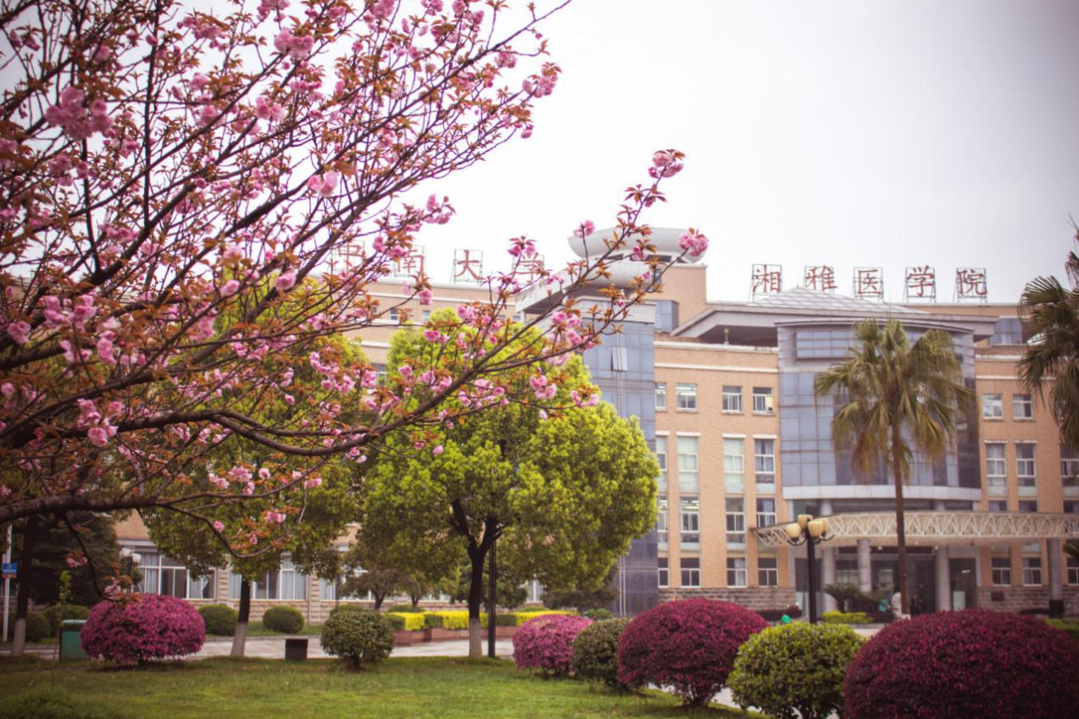
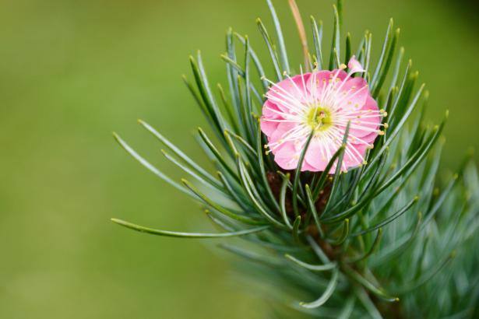
I love you more than I've ever loved any woman. And I've waited longer for you than I've waited for any woman.I love you more than I've ever loved any woman. And I've waited longer for you than I've waited for any woman.
Click here to add your title
I love you more than I've ever loved any woman. And I've waited longer for you than I've waited for any woman.I love you more than I've ever loved any woman. And I've waited longer for you than I've waited for any woman.

Slide 24
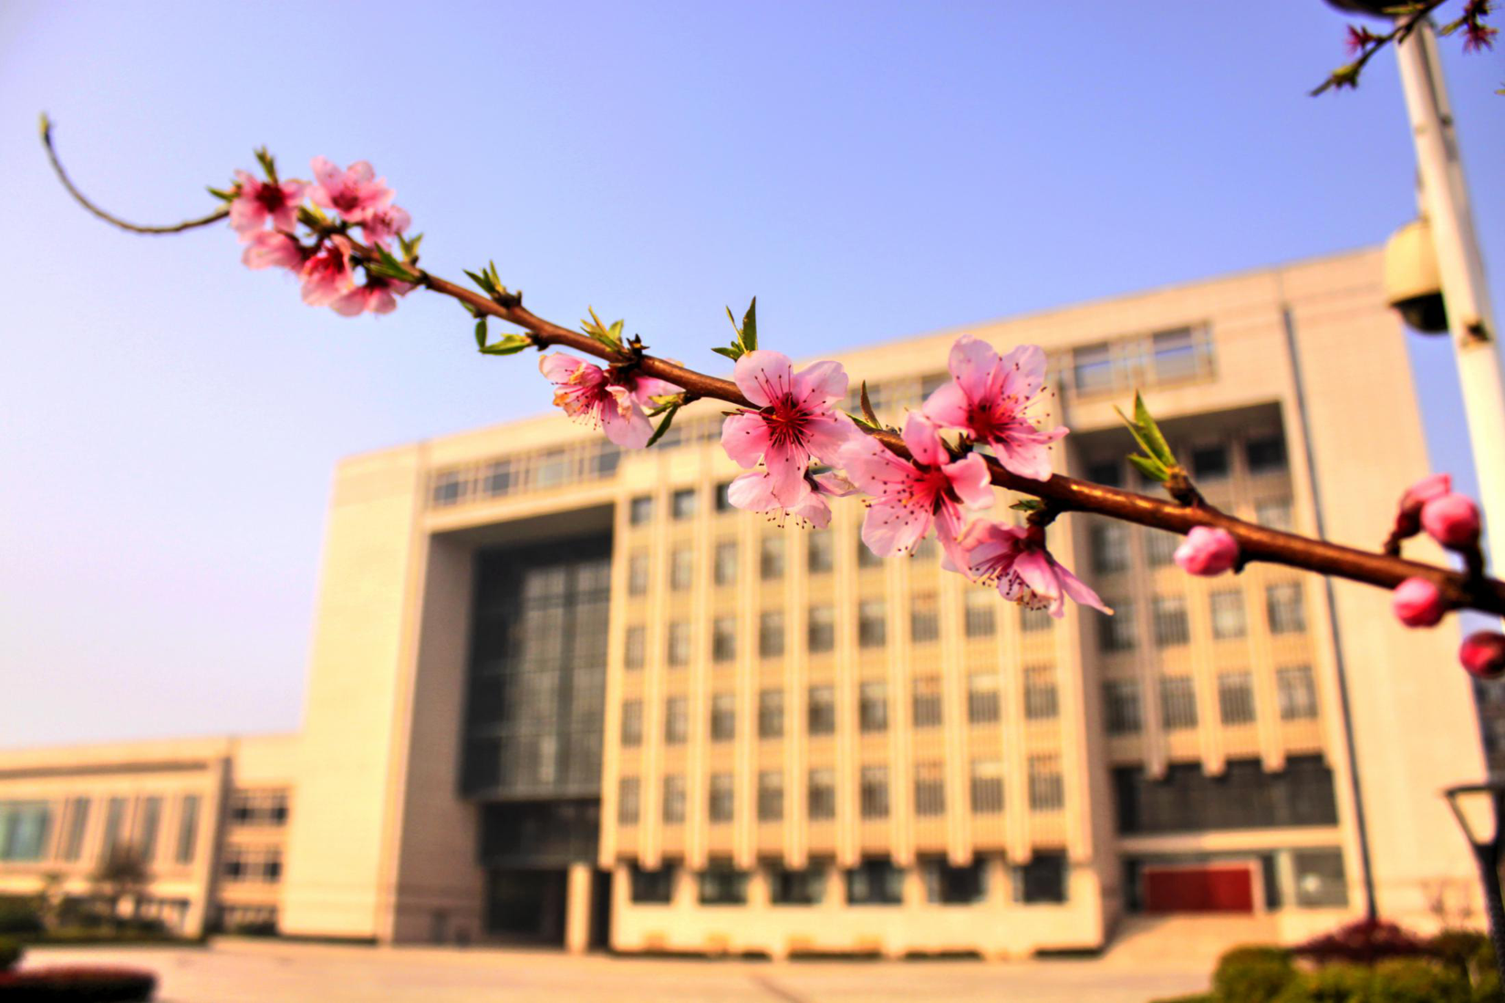
敬请指正
感谢指导

Slide 25

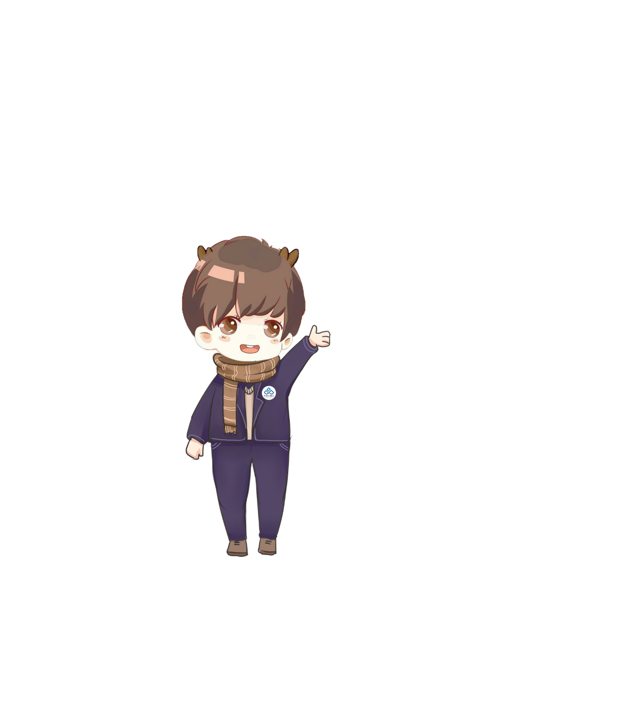



热烈庆祝中南大学
合并组建20周年
“中南云麓谷”新媒体中心 出品
中南大学学生工作部（处）官方微信
关注微信公众号“中南云麓谷”
定期共享优质资源

